Slide 1

Kidney disease prediction
Course: Professional training in programming ||
Group members:
Youssef moustafa 20104848
Anas Magdy 20104847
Khaled Ehab 20106166
Abdelrahman Sherif 20107171

Slide 2
Introduction
The purpose of this project is to make the most accurate prediction of whether a person will have a risk of getting a heart disease or not based on a dataset we’ve selected on Kaggle.
In order to accomplish that we’ve worked on all 5 models covered throughout the semester to select the model with the best accuracy. And therefore, conclude with our prediction that will be made later on flask.
The model will consist of 25 independent variables (predictors) and 1 dependent variable which shows if that person has a disease or not.

Slide 3
Contents
Models:
Multi linear regression
Polynomial regression
KNN – K nearest neighbors
SVM – Support Vector Machine
Logistic regression
Implementation using Flask & pickle.

Slide 4
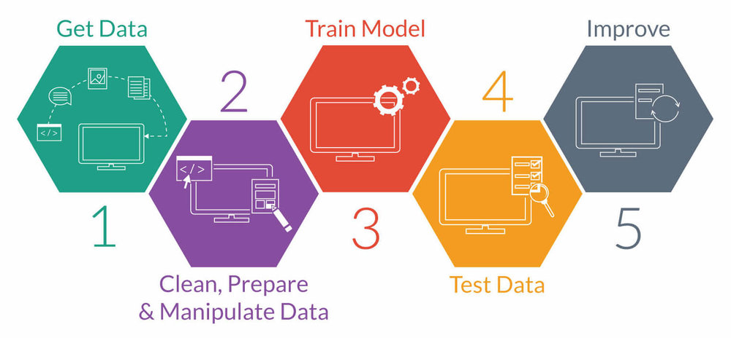
Models:
When coming to the models. We’ve used all 5 models to identify the model with the highest accuracy to work on it then on flask.
Afterwards, It was shown that the SVM was the model with the highest accuracy which was around 95.8%. So, we’ve decided to work on that model.
Note : Each model takes 25 inputs.

Slide 5
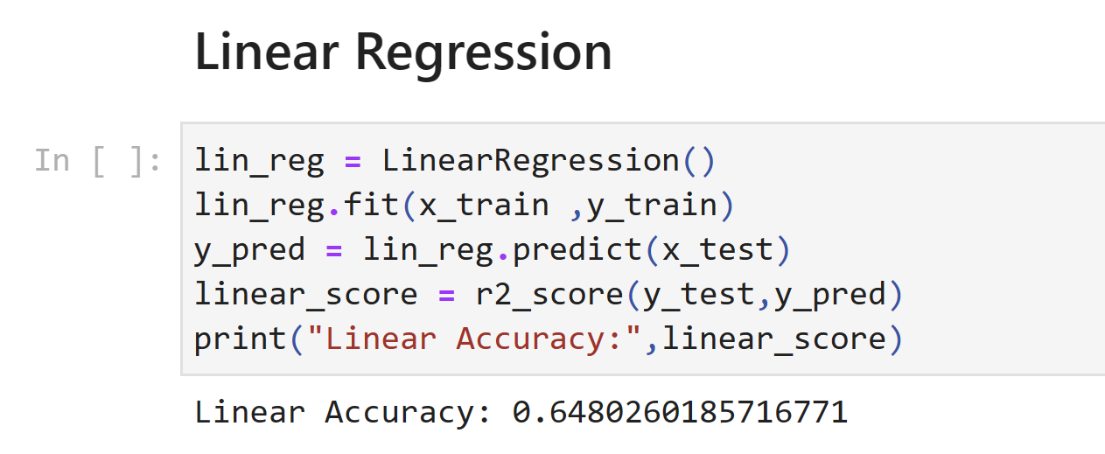
1. Multi linear regression

Slide 6
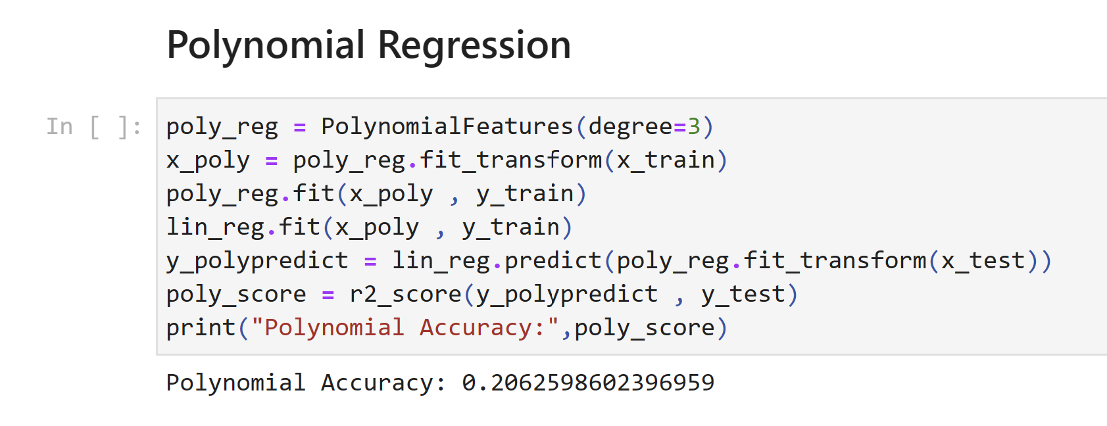
2. Polynomial regression degree= 3.

Slide 7
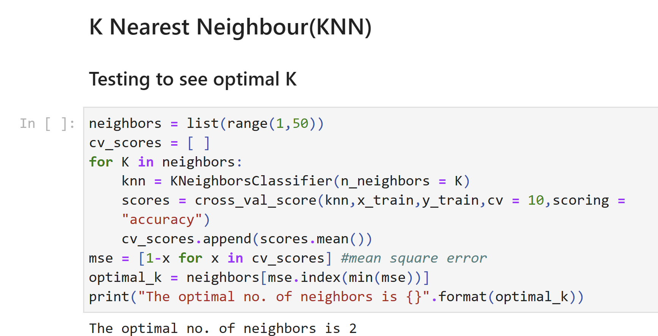
3. KNN – K nearest neighbors k=2

Slide 8
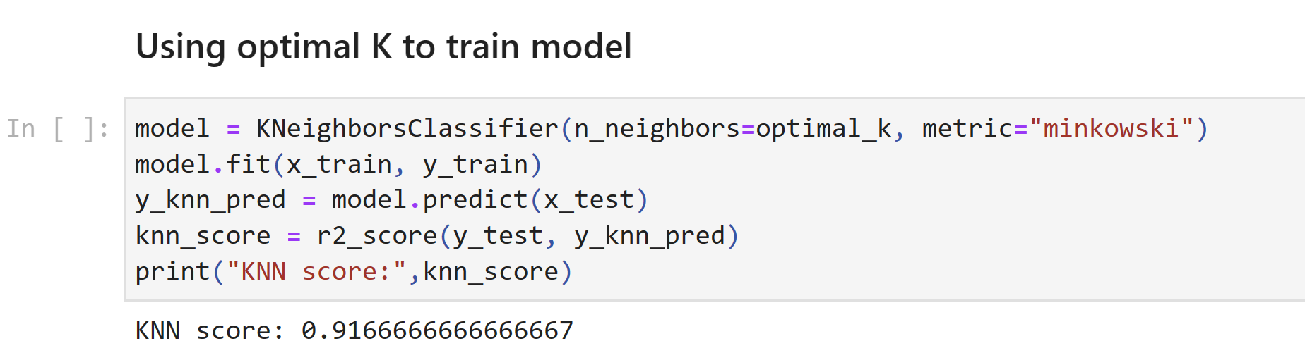

Slide 9
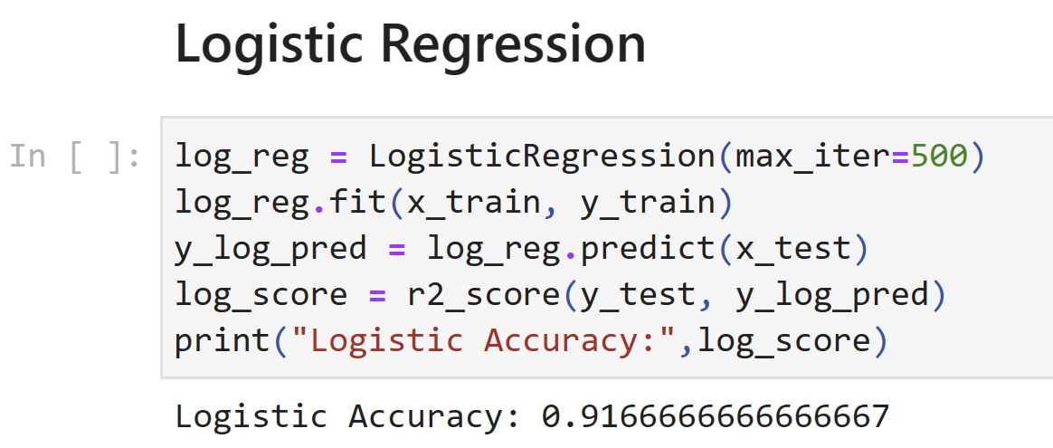
5. Logistic regression

Slide 10
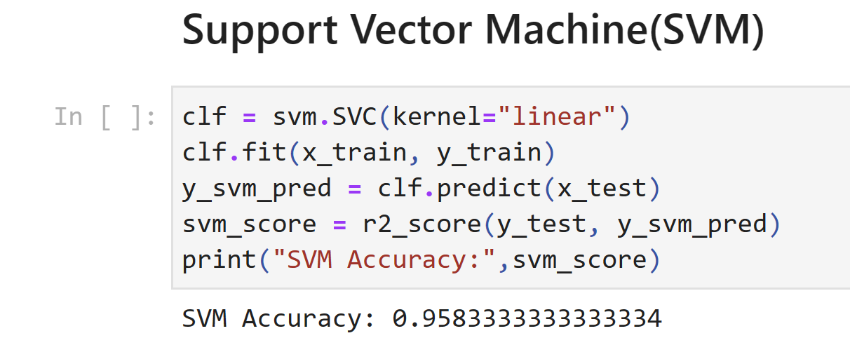
4. SVM – Support Vector Machine

Slide 11
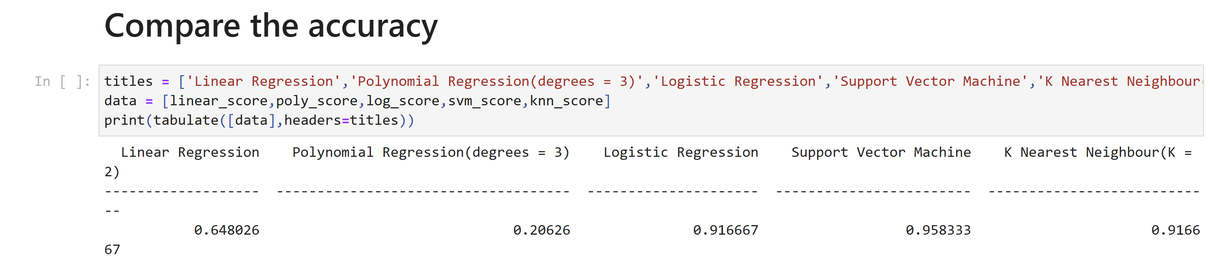

Slide 12
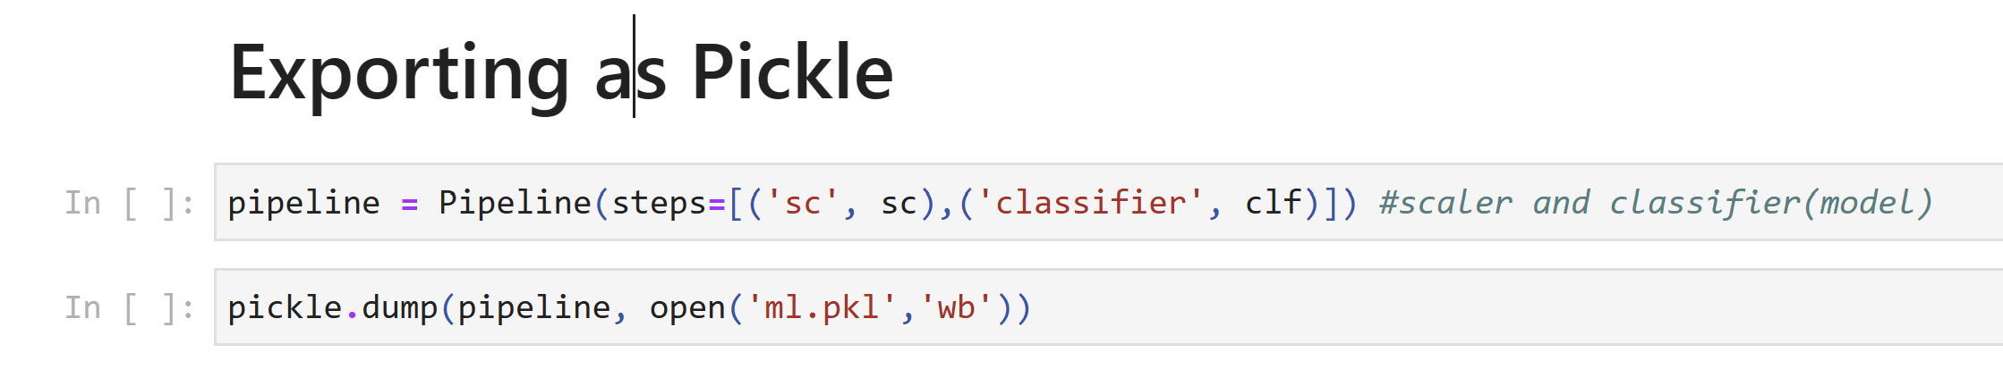
So, It appeared that the SVM had the highest accuracy. As a result, we exported this model as pickle. To conclude with our predication.

Slide 13
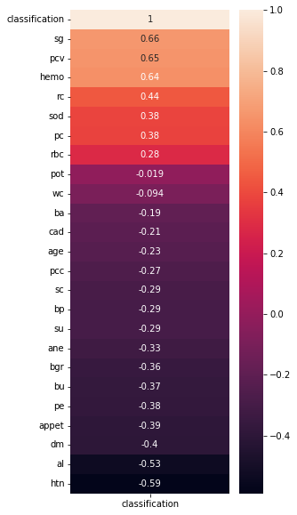
Heatmap

Slide 14
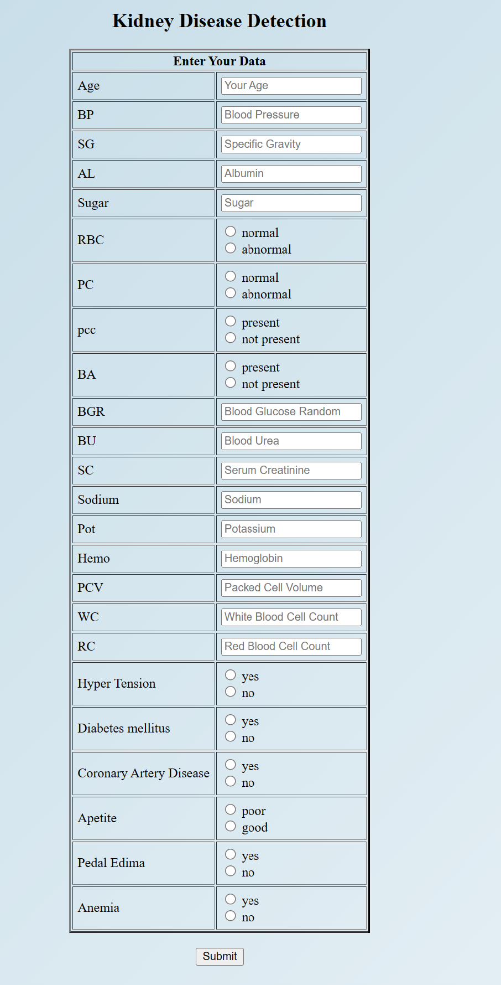
Implementation using Flask & pickle. Note that the model takes 25 inputs as a data for the prediction.

Slide 15
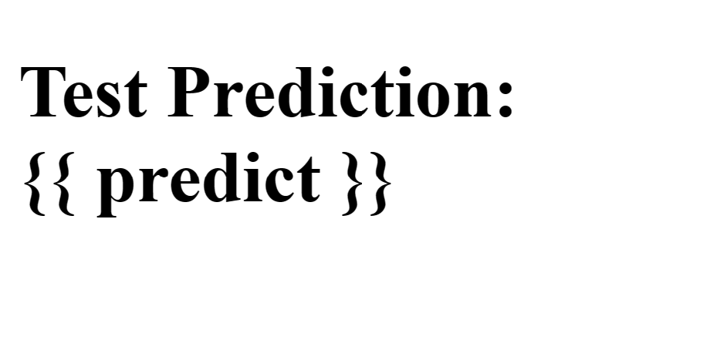
Based on the data prompted. The prediction will be made. The result will either be 0 or 1. 0 – There is a risk of having a kidney disease. 1- There is no risk of having a kidney disease.

